Slide 1

FLOWCHARTS & DIAGRAMS

Slide 2
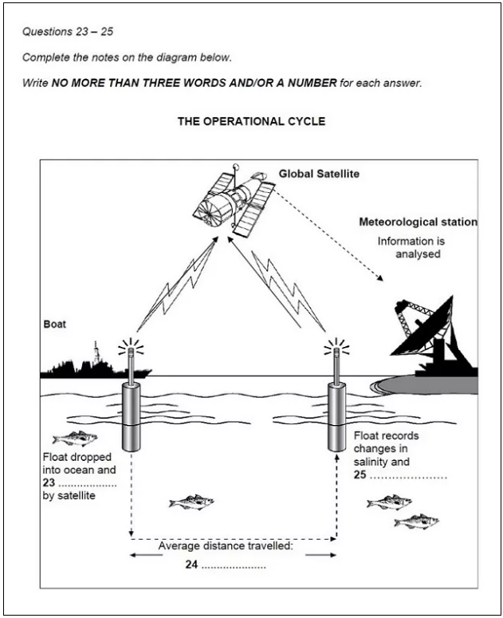
Diagram

Slide 3
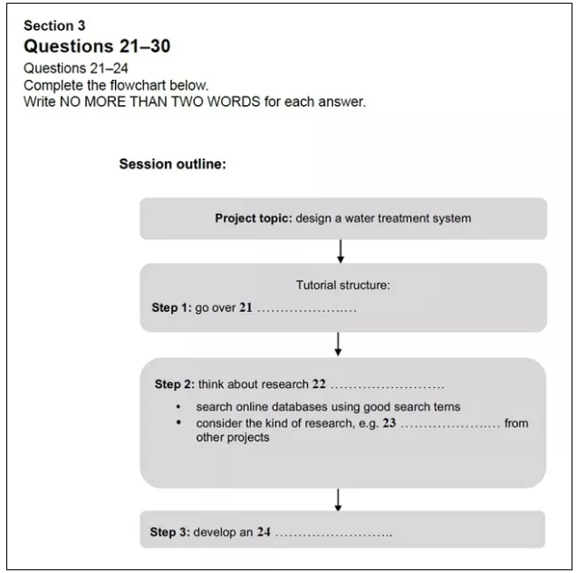
Flowchart

Slide 4
Read the Instructions
Read the instruction carefully, paying particular attention to how many words you’re allowed to write for the answer.
The instructions for our sample diagram question state that you must,
Write NO MORE THAN THREE WORDS AND/OR A NUMBER for each answer.
If you write more than three words, your answer will be marked incorrect even if the information you give is correct.
Other questions might tell you to write NO MORE THAN TWO WORDS or ONLY ONE WORD, so be careful.

Slide 5
Read the Labels & Title
Learn as much as you can from the title and existing labels. The information you get from them will help you to understand the diagram and give you clues as to what the speaker(s) will talk about.

Slide 6
Predict the Answers
Try to predict what the answers might be. This will focus your mind on what to listen out for in the recording.
Occasionally, you’ll be able to predict the actual word but mostly it’s one of these things that you’ll be able to determine:
The type of information required, e.g. a name, a number, a percentage.
The type of word required, e.g. noun, adjective, verb.
Predictions:
23 – a verb
24 – a number (measurement)
25 – a noun

